Slide 1

Safety risk methodology and metrics with open-source tools and open data
Student: Kathlyn Anne Ycong (kyco720)
Supervisor : Simon Urbanek
Notes:
Tena koutou
I hope everyone had a lovely weekend.
Our research is about ‘Safety risk methodology and metrics with open-source tools and open data’

Slide 2
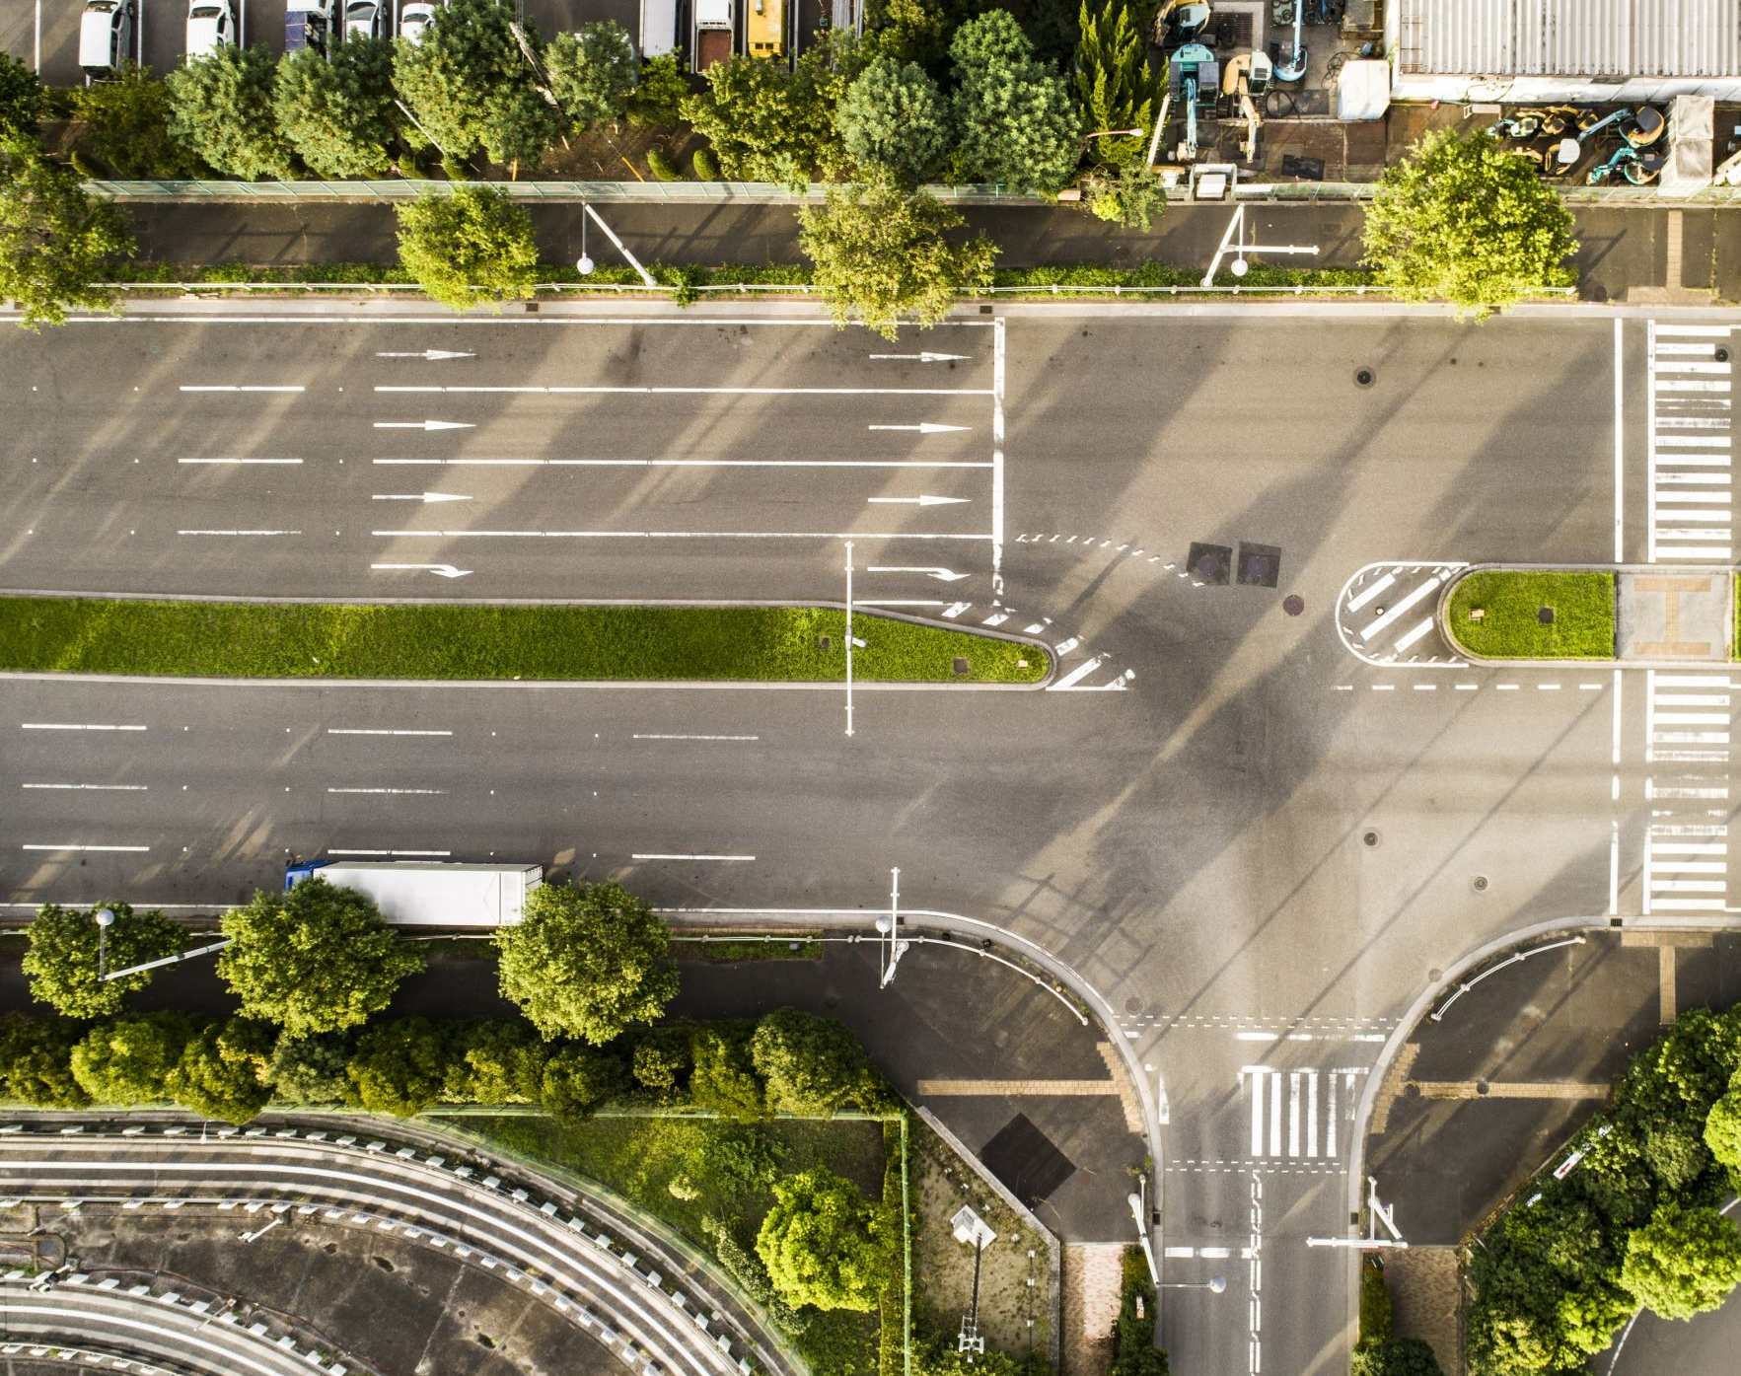
Project Aim
Analysing road safety in New Zealand
Leveraging journey to work data from Statistics New Zealand and crash data from Waka Kotahi New Zealand Transport Agency
Develop an R package that includes data and functions to analyse road safety
Notes:
According to the World Health Organisation (WHO), the global death toll from traffic accidents is 1.35 million annually, causing social and financial implications [2]. In New Zealand, at least one person dies, and seven others sustain serious injuries from traffic accidents every day [1]. Data and analytics are essential in understanding road crashes. It can enable an in-depth understanding of potential factors contributing to the problem and ultimately support prevention measures such as developing and implementing policies and changes to road systems that mitigate road safety risks [3].
The ministry of transport commissioned this research to analyse road safety.
It was inspired by a similar research conducted in the UK by researchers at the University of Leeds to analyse the road safety of active commuters.
In this research, we are trying to analyse road safety for commuters driving from their usual residence to their workplace in Auckland, New Zealand by leveraging open-source data from Statistics New Zealand and Waka Kotahi New Zealand transport agency. We then bundle the data and functions for spatial data analysis in an R package with the intent to share, iterate and evolve the research over time.

Slide 3
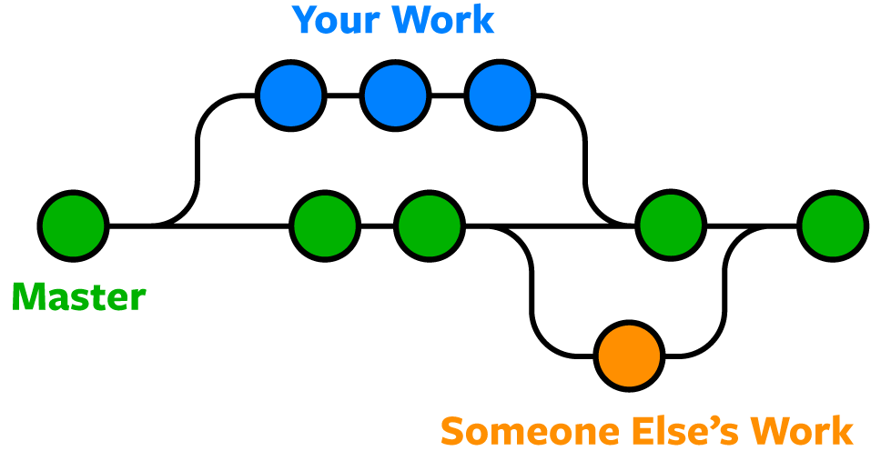
Open-Source Package Development
Testing
Documentation
Create Package Structure
Sharing
Develop functions (includes data gathering)
Using Github for version control and collaborating work with others.
Notes:
R is the programming language used in this research. In R, packages are valuable tools for sharing work with others by bundling code, data, documentation, and tests.
The workflow of developing an R package involves
1. Firstly, Developing functions
-A function is a set of statements organized together to perform a specific task.
-the methodology and data in this research are turned into functions.
-in this step, a lot of code modification and code tests are involved to ensure that the functions developed is fit for purpose and robust
2. Creating a package structure
The next step is creating the basic structure of the package which will help you navigate the requirements to develop an R package such as the documentation and tests that are needed
3. Documentation
Thirdly, Documentation is one of the most important aspects of a good package. It will help users how to use the package and it is also useful for you and for other developers who wanted to extend the package
4. Testing
Testing is a vital part of package development. It ensures that the code does what it intends to do.
5. Lastly, Sharing your R package
There are a few ways to share an R package, in this research, the approach we used was to make this available to everyone on Github.
Github is a platform that allows us to perform version control and collaborate throughout this research.

Slide 4
R Package Overview
motroadsafety R Package available in GitHub (kathycong/motroadsafety)
## data
data(“cas_data_akl_2018_proj”) ## 2018 crash data
data(“jtw_driving_akl”) ## 2018 journey to work data
data(“sa2_clipped_proj_akl”) ## 2018 Statistical Area 2 clipped polygons
get_routes() ## simulating routes
get_dist_travel() ## calculating distance travelled per polygon
get_risk() ## calculating road safety risk
route_risk() ## calculating journey riskiness
get_route_intersects() ## getting indices route or polygon intersects
Reference: Wickham, H. (2015). R packages: organize, test, document, and share your code. " O'Reilly Media, Inc.".
Notes:
The R package developed in this research is called motroadsafety.
The package is currently accessible on Github.
The package includes the data in road safety data analysis in Auckland, which is the crash data, journey to work data and the statistical area 2 polygons.
The analysis was translated into R functions, such as get_routes, which simulate the routes given a pair of coordinates.
The get_dist_travel function calculates road safety exposure or the distance travelled.
The get_risk function is used to calculate road safety risk.
The route_risk function is used to calculate route riskiness
Lastly, the get_route_intersects function returns the indices of either the route or polygon that the polygon or route has intersected.

Slide 5
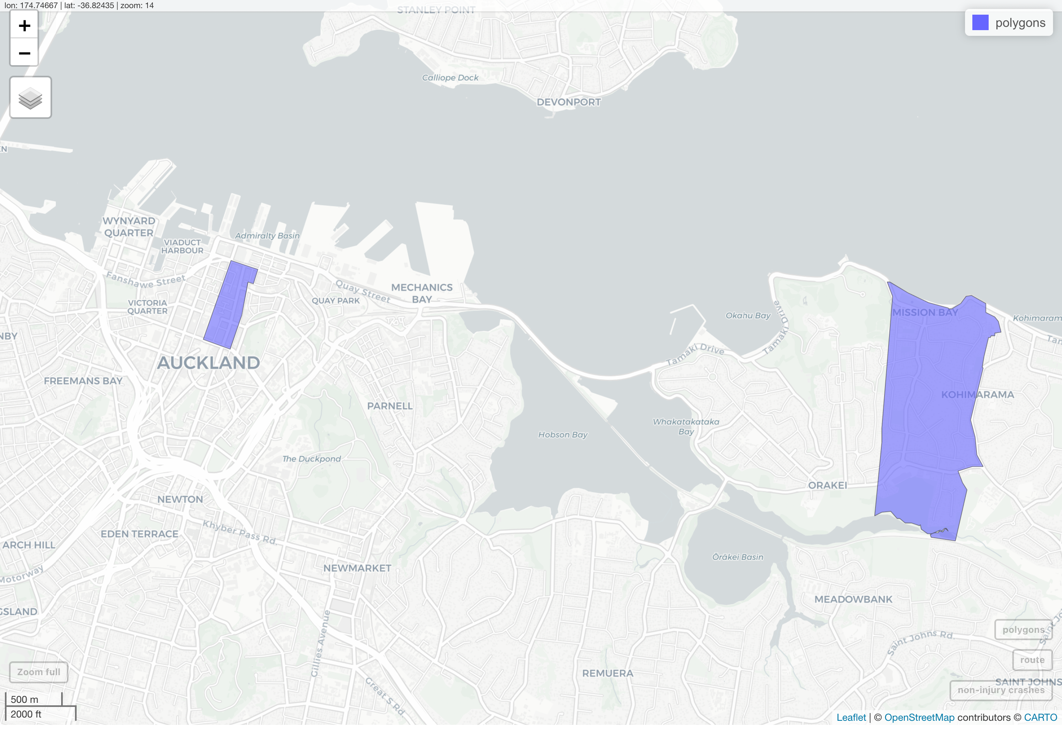
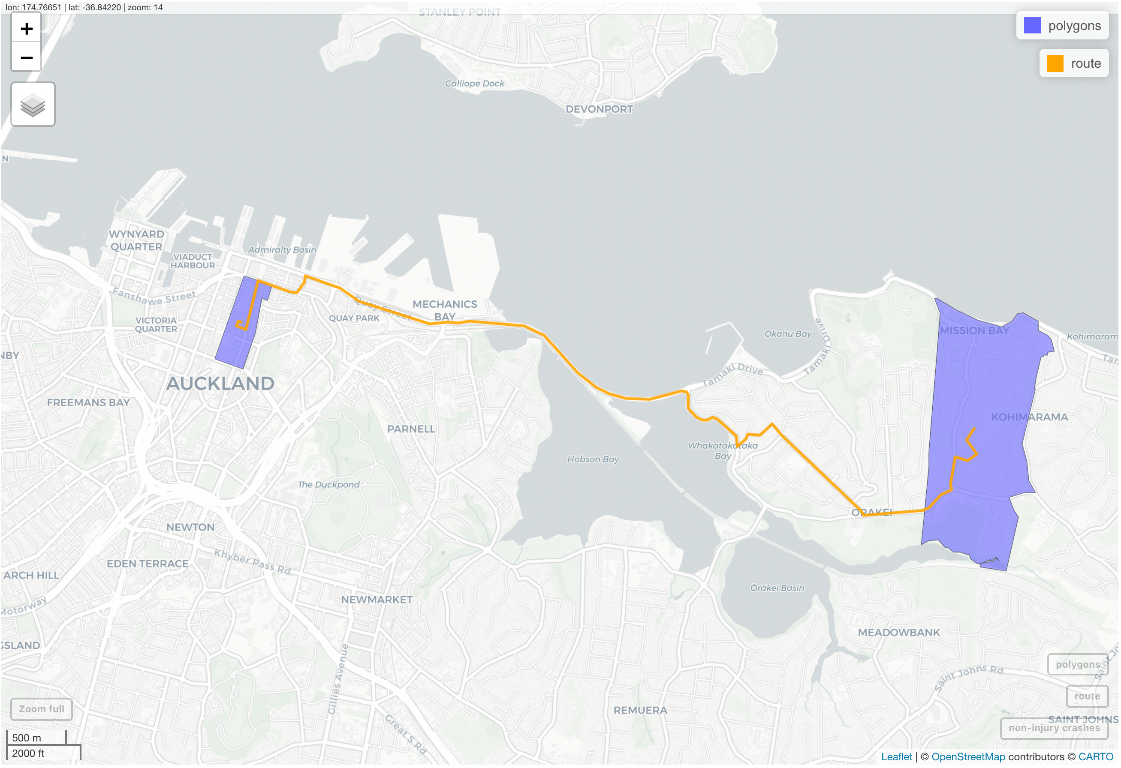
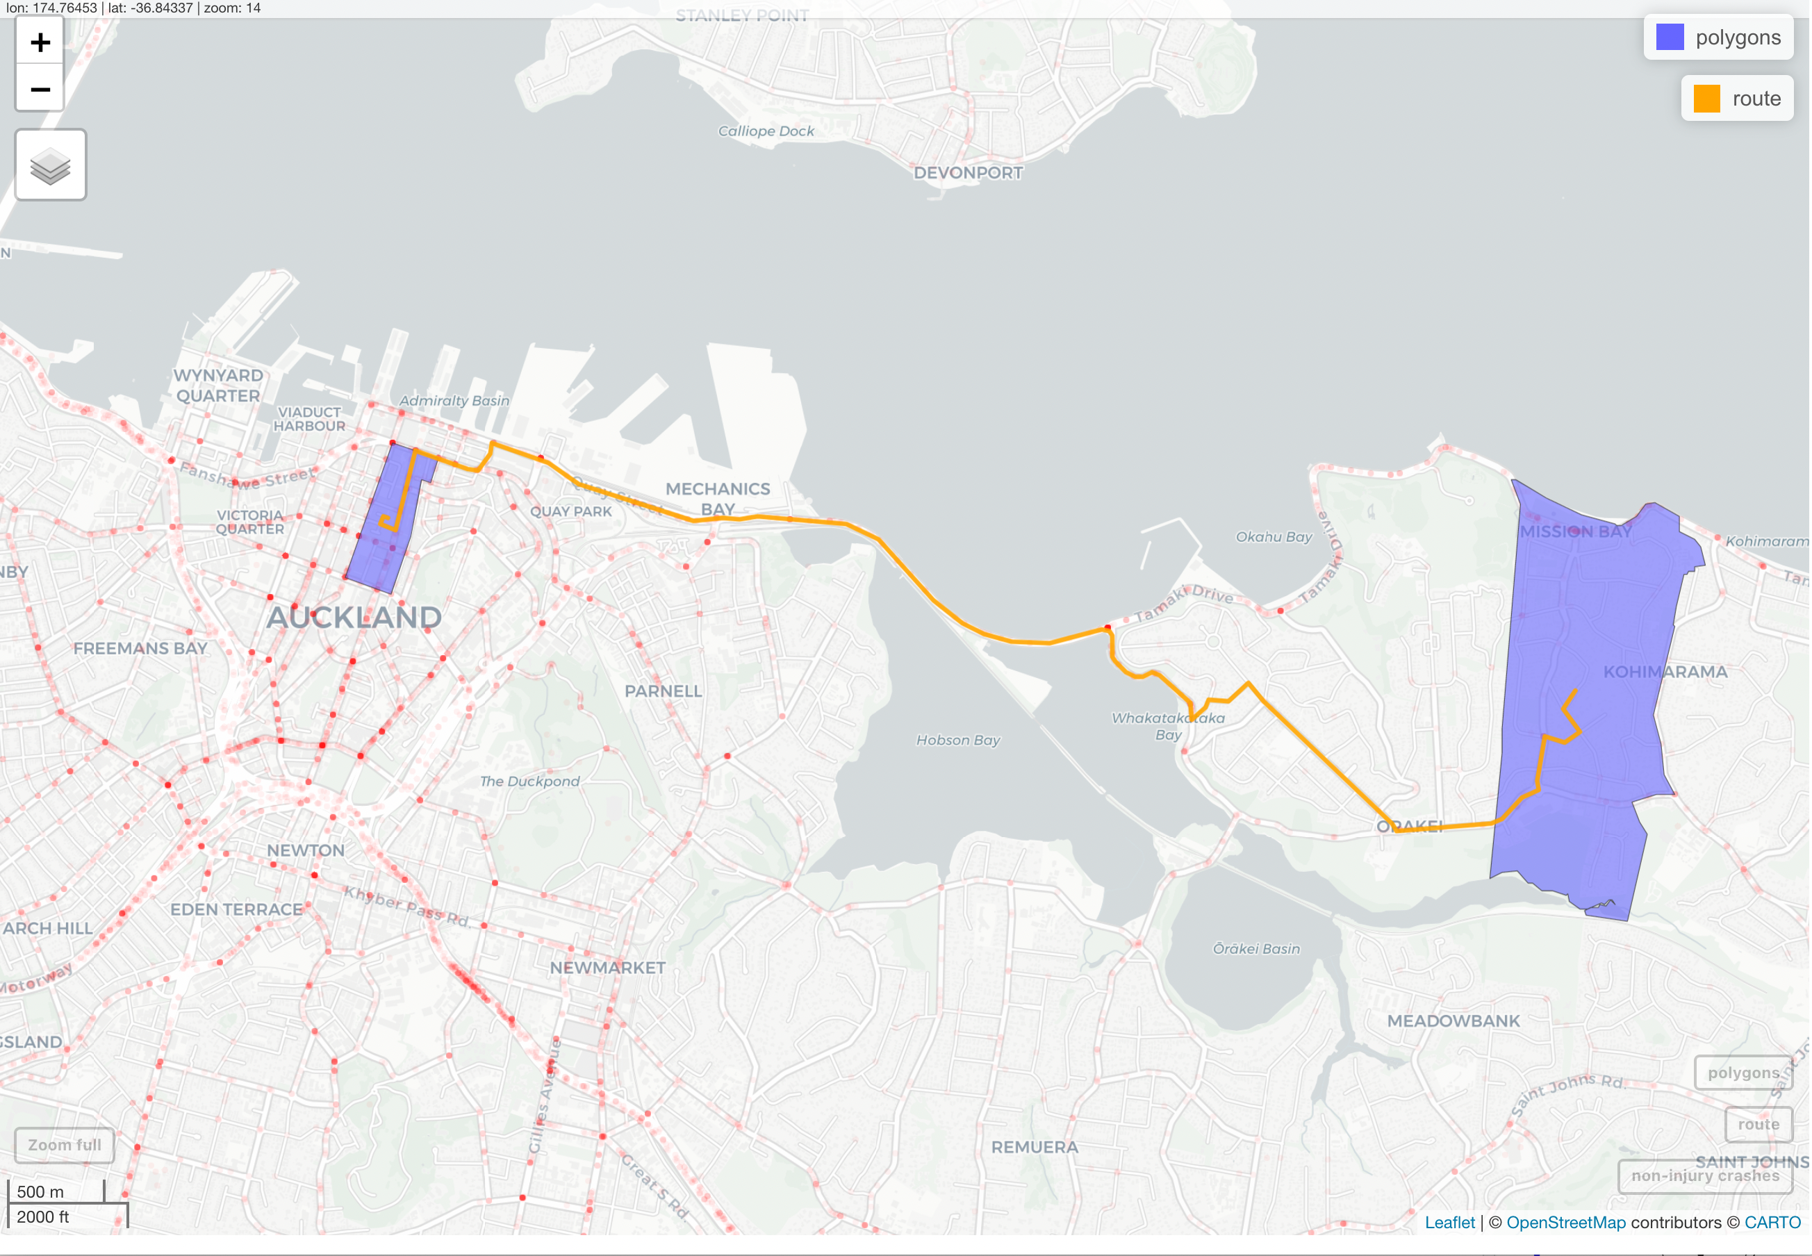
Dataset Analysis
2018 Census Main Means to Work Data (journey to work data)
Statistical Area 2 Polygons
Crash Analysis (CAS) Data
Home
Work
Notes:
The research uses three open source data sets:
1.The 2018 census main means to work data
2.the Statistical area 2 clipped polygons data
3.and the Crash Analysis Data.
The 2018 main means to work data, or the journey to work data, contains data of a commuter’s journey from its usual residence to its workplace. Due to data sensitivity, the locations have been aggregated to statistical area 2 or suburb level.
The plot you see now uses the journey to work data and statistical area 2 polygons.
Both of these data were extracted from Statistics New Zealand.
The polygon on the right represents the usual residence of the commuter located in Mission Bay Auckland, and the polygon on the left represents the workplace of the commuter located in Queen Street Auckland Central.
Since the journey to work data contains only centroids of the statistical area 2 locations, it was enriched with polygons to best represent the area.
The 2018 journey to work data is also used to simulate the routes for each unique usual residence and workplace coordinates pair.
As you can see in this plot, the orange line represents that route simulated by the coordinates provided from the data.
The line also represents the total distance travelled by the commuter. the end points of the line represent the centroids of the statistical area 2 polygon.
The Crash Analysis data was extracted from Waka Kotahi New Zealand Transport Agency.
It contains records of all road traffic crashes reported to the New Zealand Police.
As you can see in this plot, we overlayed it with the crash data using the coordinates provided which are represented by the red dots.
Crashes have various severity, fatal, serious, minor, and non-injury crashes.
The majority of the crashes are non-injury crashes.
Crashes usually occur at road junctions and on heavy traffic roads like the motorway.

Slide 6
Methodology
Simulating routes using ghroute package
Calculating exposure using the distance travelled
Calculating total crash sites encountered by a commuter’s journey
1. Simulating Routes
3. Calculating Exposure
4. Road Safety Risk
6. Spatial Autocorrelation
5. Route Riskiness
2. Validating Routes
Using AT Traffic counters to validate simulated traffic volume
Calculate risk with exposure and total injury crashes
Geospatial data analysis to determine spatial clusters
Notes:
Assumptions:
The assumptions in this research are that the simulated routes are the best routes from the commuter’s usual residence to their respective workplace, the crashes and one-way commute occurred during peak hours (between 7:30 am and 9:30 am) on a weekday, and the centroids of the statistical area 2 are the residence of the commuters and workplace. These assumptions are in place because of dataset limitations.
The methodology of this research involves:
Firstly, simulating the routes using the ghroute package.
we then wanted to validate the routes simulated by comparing the traffic volumes generated by the simulated routes and the traffic volume recorded by Auckland Transport.
Thirdly, we calculated the exposure using the data from the routes simulated.
Next, we calculated road safety risk a known road safety measure.
We also wanted to quantify the riskiness of the journey.
Lastly, we conducted spatial autocorrelation for spatial data analysis to identify the existence of global spatial autocorrelation and determine if there are hot spots or cold spots.

Slide 7
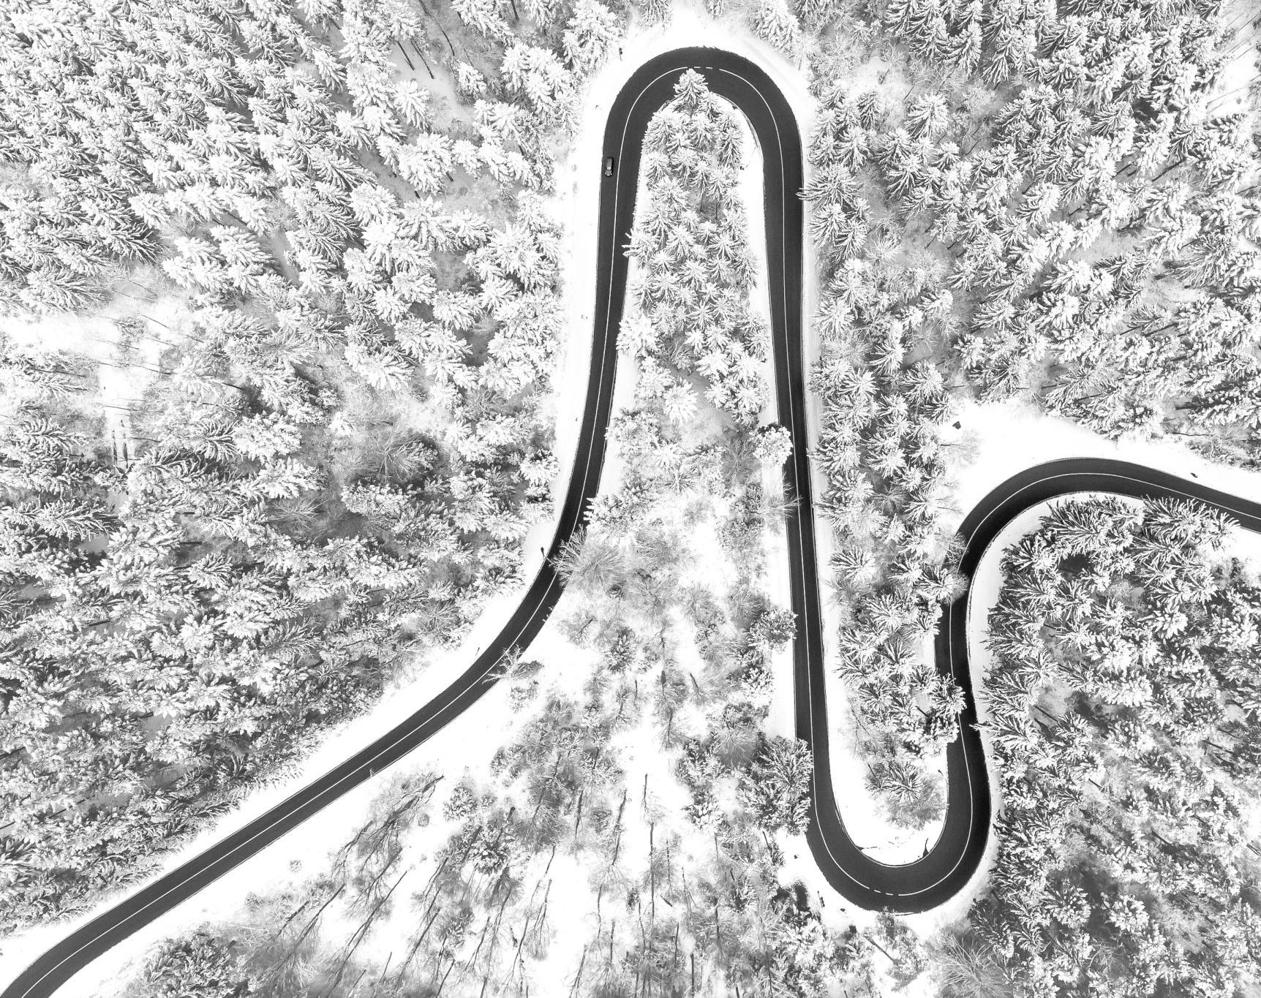
Simulating Routes
Ghroute Package
Leverages GraphHopper routing algorithm and OpenStreetMap (OSM) protocolbuffer binary format (PBF) file of New Zealand
Simulates a single route between any unique origin and destination pair
Requirements :
Latitude and Longitude Coordinates
Travel Mode (e.g., car, public transport)
Output:
Distance Travelled (meters)
Total Time Travelled (seconds)
Linestring geometry
Notes:
The most crucial step in this research is simulating the routes based on the journey to work data from statistics New Zealand.
The ghroute R package was used in this research to simulate the routes. This package was developed by my supervisor Simon Urbanek. The Package uses the routing algorithms from graphhopper to find the optimal route. The package requires a protocolbuffer binary format or PBF file of New Zealand, which contains all the possible routes in New Zealand.
The routing algorithm uses the PBF file to simulate the optimal route by providing the latitude and longitude coordinates of your source and destination locations and setting the travel mode.
In this study, we were only interested where commuters were driving from home to work.
The result from this is the distance travelled in meters, the total time travelled in seconds, and a linestring geometry or a line in the map that visually represents a commuter’s journey.

Slide 8
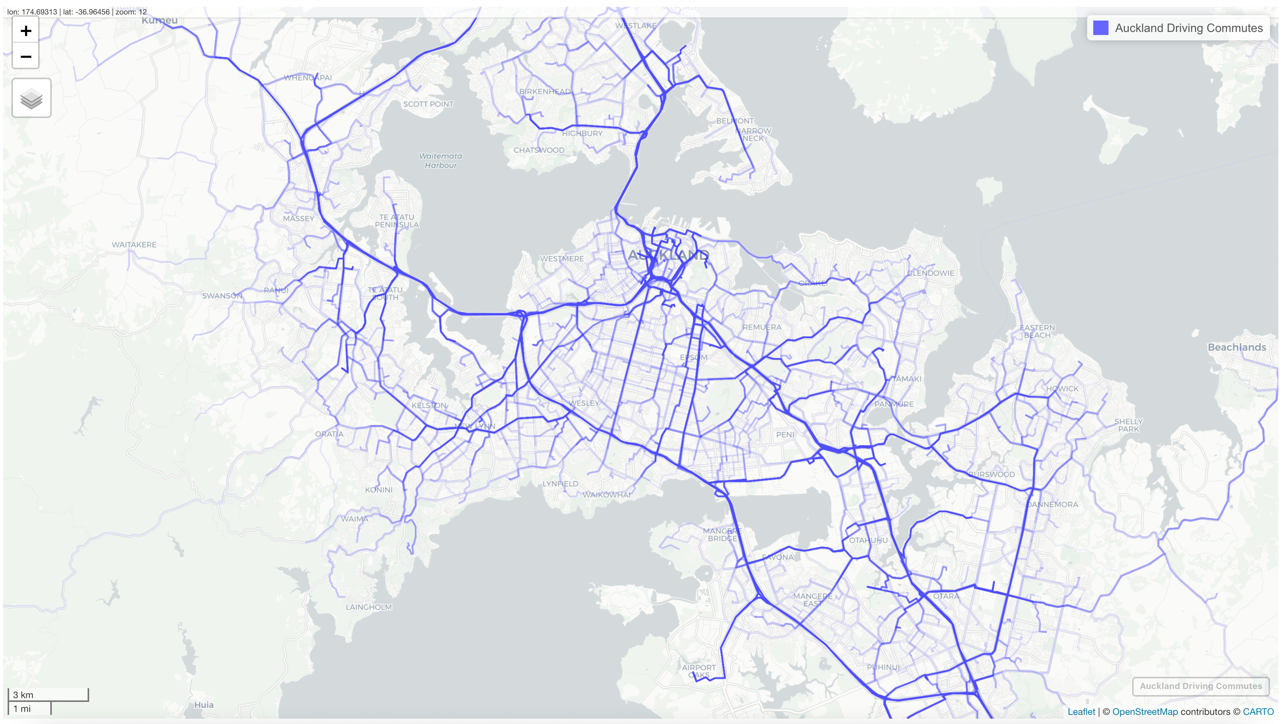
Simulating Routes
16,031 unique routes where the usual residence of the driver is in the Auckland region
102 unique usual residence and workplace pairs that had no routes
15,929 total routes simulated
Notes:
The advantage of using ghroute to simulate the routes is its efficiency. For approximately 16,000 routes, it was able to complete the simulation in less than 10 minutes.
The blue lines on the plot from the left represent simulated routes, and it is noticeable that most routes are on busy roads, such as motorways.
The journey to work data where the usual driver residence is in the Auckland region had 16,031 unique routes. We were only able to simulate 15,929 unique routes. There were 102 unique usual residence and workplace pairs that had no routes.
South Head, Kawakawa Bay-Oreore, Waipatukahu, Waitakere Ranges South, Waitakere Ranges North and Okura Bush are the predominant usual residence statistical area 2 geographic units that had no possible route between drivers’ usual residence to their workplace.
A limitation of using Statistical area 2 centroids as coordinates such that not all possible routes in Auckland have been exhausted.

Slide 9
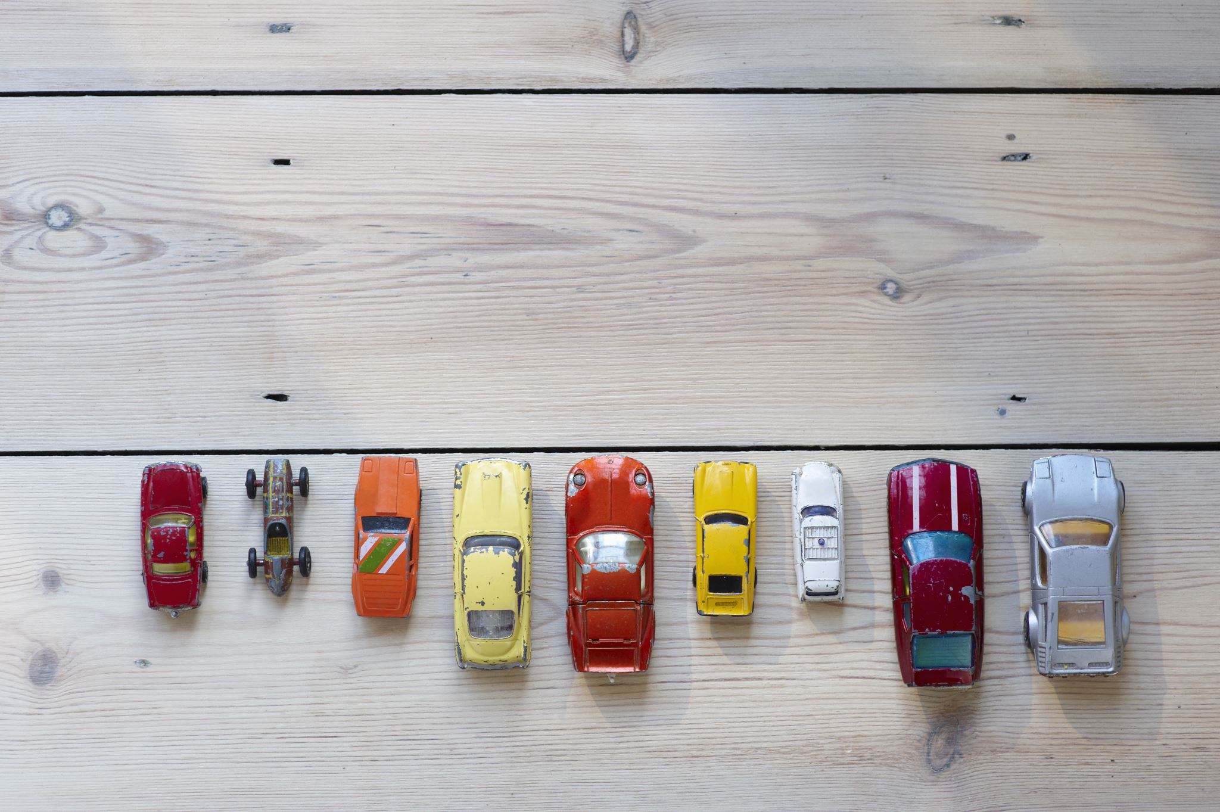
Calculating Exposure
Exposure
a road safety measure of the amount travelled by a commuter
road user's likelihood of being involved in a dangerous or hazardous situations (Pei, Wong & Sze, 2012).
traffic volume
conflicts
the amount of distance travelled - used in this study
amount of time travelled
fuel consumed
Reference: Pei, X., Wong, S. C., & Sze, N. N. (2012). The roles of exposure and speed in road safety analysis. Accident analysis & prevention, 48, 464-471.
Notes:
Exposure has been defined as the road user’s likelihood of being involved in a dangerous or hazardous situation. Exposure can be defined differently depending on the data available. It could be traffic volume, traffic conflict, distance travelled, the time travelled or fuel consumed.
Exposure in this research is the total distance the commuters travelled from home to work.
It was derived from the routes simulated in the previous step.

Slide 10

Road Safety Risk
- the probability of a traffic accident occurring (Hakkert et al, 2002).
$$Road safety risk=\frac{consequence}{Exposure}$$
Where:
consequence
-the road safety outcome, typically the total number of fatalities or serious injuries (Shah, et al., 2018)
exposure
- road user's likelihood of being involved in dangerous or hazardous situations (Pei, Wong & Sze, 2012)
Reference:
Hakkert, A. S., Braimaister, L., & Van Schagen, I. (2002). The uses of exposure and risk in road safety studies (Vol. 2002, No. 12). SWOV, Leidschendam: SWOV Institute for Road Safety.
Shah, S. A. R., Ahmad, N., Shen, Y., Pirdavani, A., Basheer, M. A., & Brijs, T. (2018). Road safety risk assessment: an analysis of transport policy and management for low-, middle-, and high-income Asian countries. Sustainability, 10(2), 389.
Pei, X., Wong, S. C., & Sze, N. N. (2012). The roles of exposure and speed in road safety analysis. Accident analysis & prevention, 48, 464-471.
Notes:
The road safety risk is a common road safety measure. It is the probability of a traffic accident occurring.
Given the crash data from Waka Kotahi New Zealand Transport Agency and the exposure data from the simulated routes we were able to calculate the road safety risk for each statistical area 2 or suburb in Auckland which is defined as the total injury crashes divided by the total exposure per area.

Slide 11
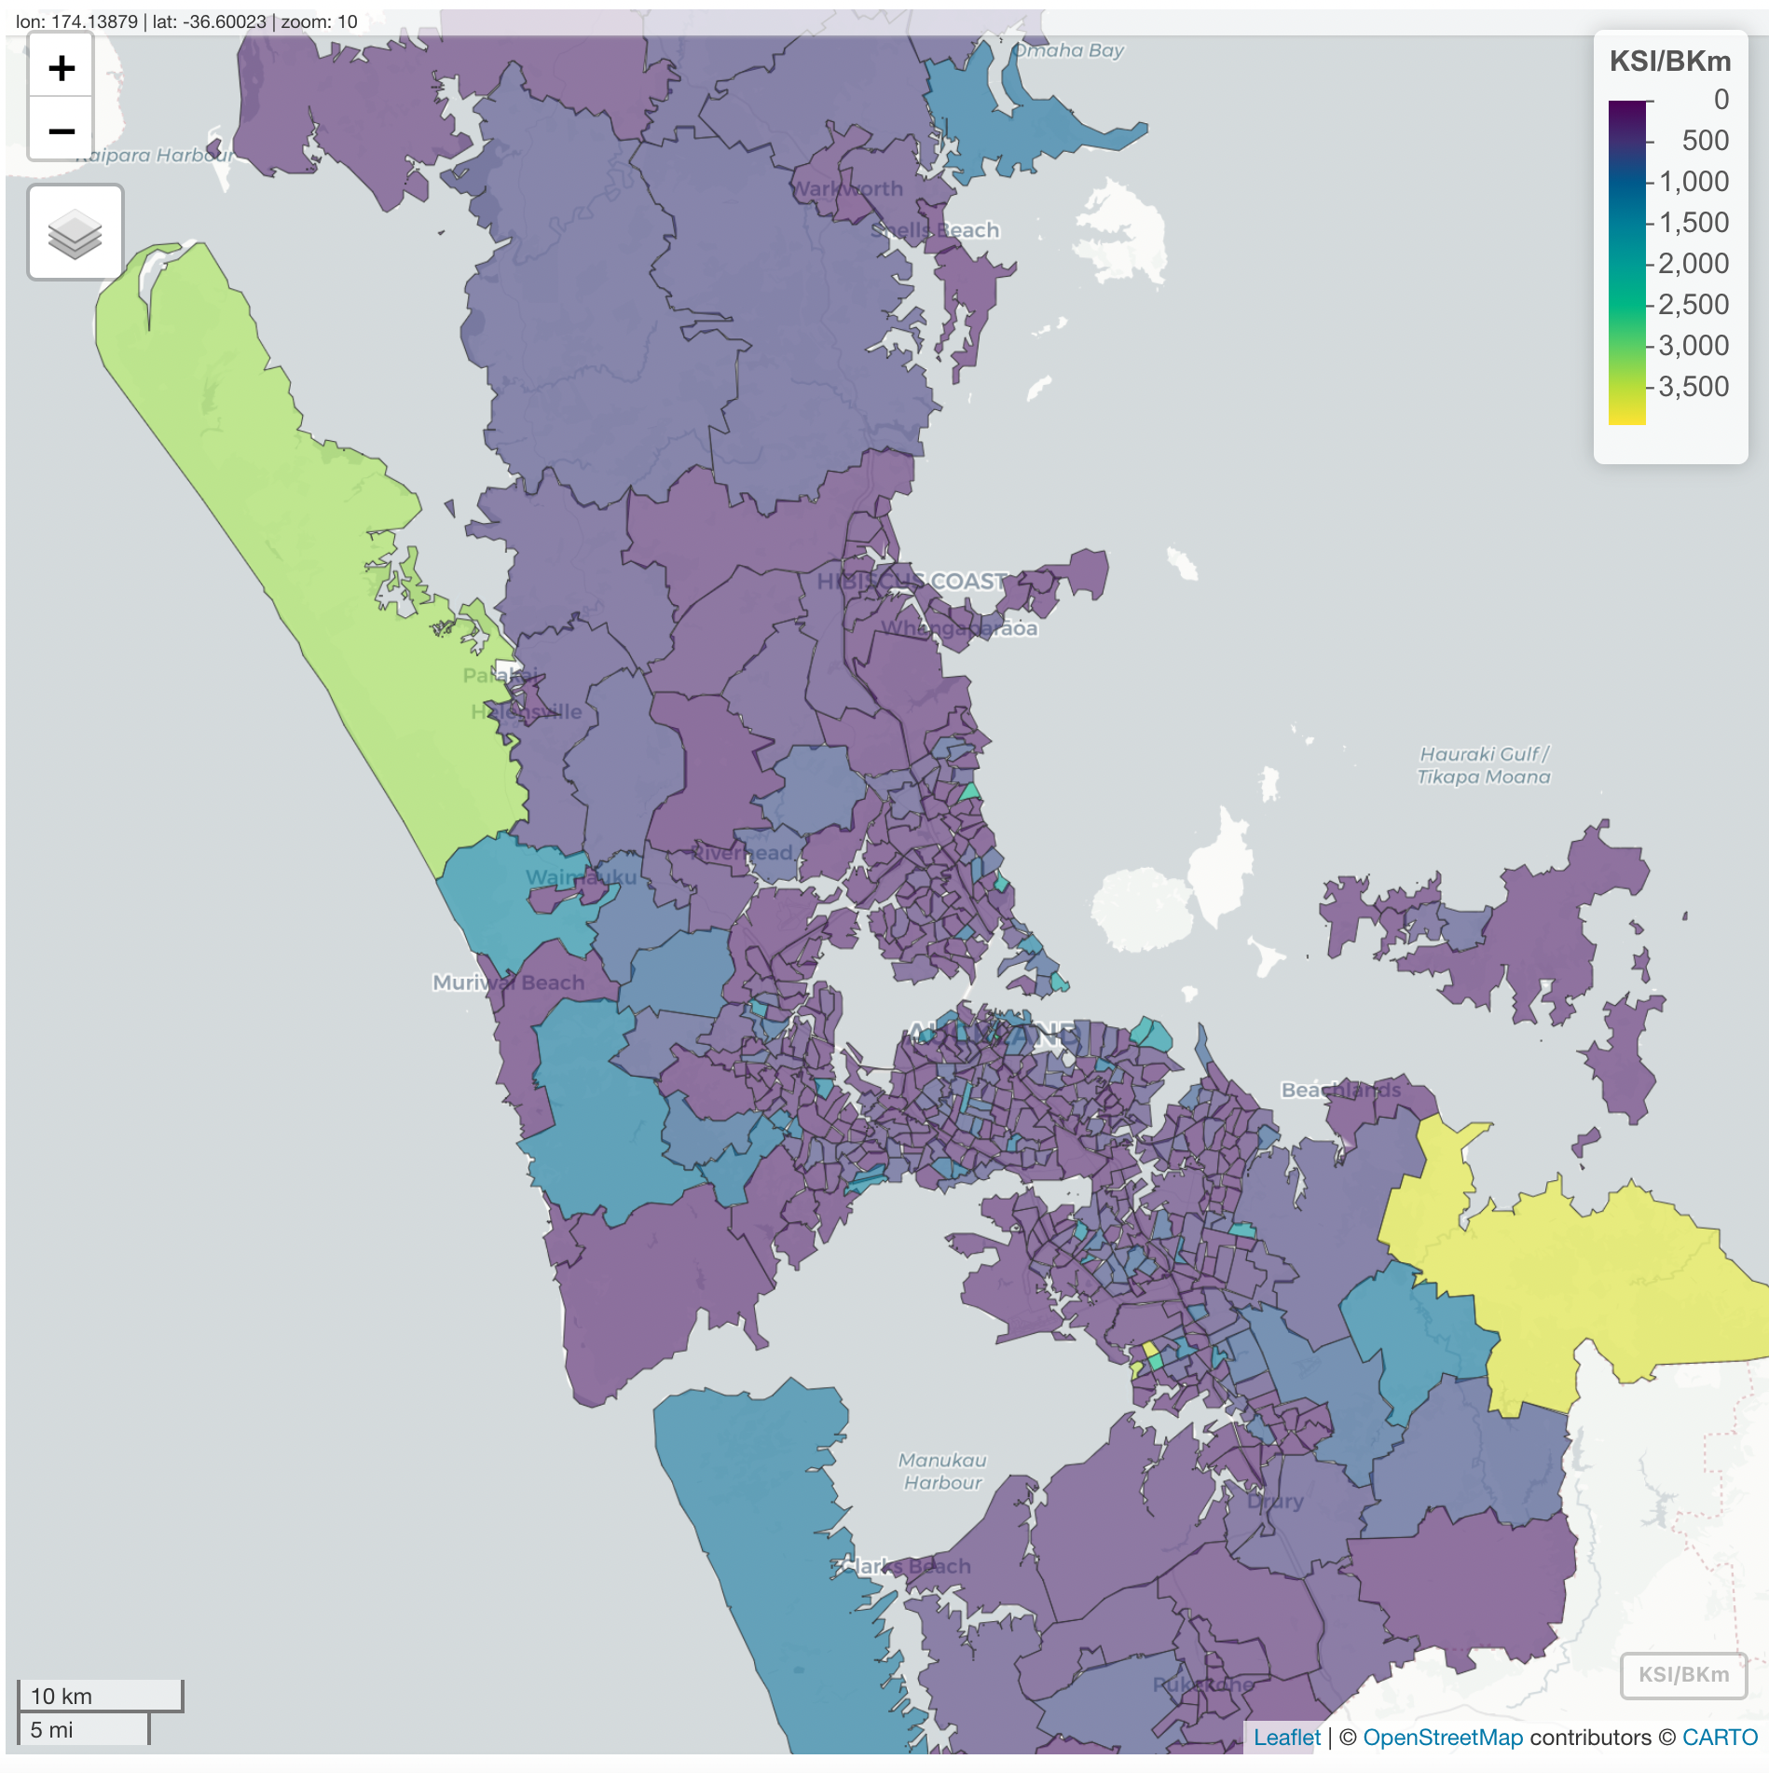
Road Safety Risk
Areas (SA2 polygons) where there is less traffic volume, but high count of traffic accidents tend to be riskier compared to areas where there is high traffic volume and comparable traffic accidents.
Notes:
This plot visually represents the road safety risk for each statistical area 2 or suburbs in Auckland.
Thus, areas where there is less traffic volume, but a high count of traffic accidents tend to be riskier ( represented by the green and yellow polygons) compared to areas where there is high traffic volume and comparable traffic accidents.

Slide 12
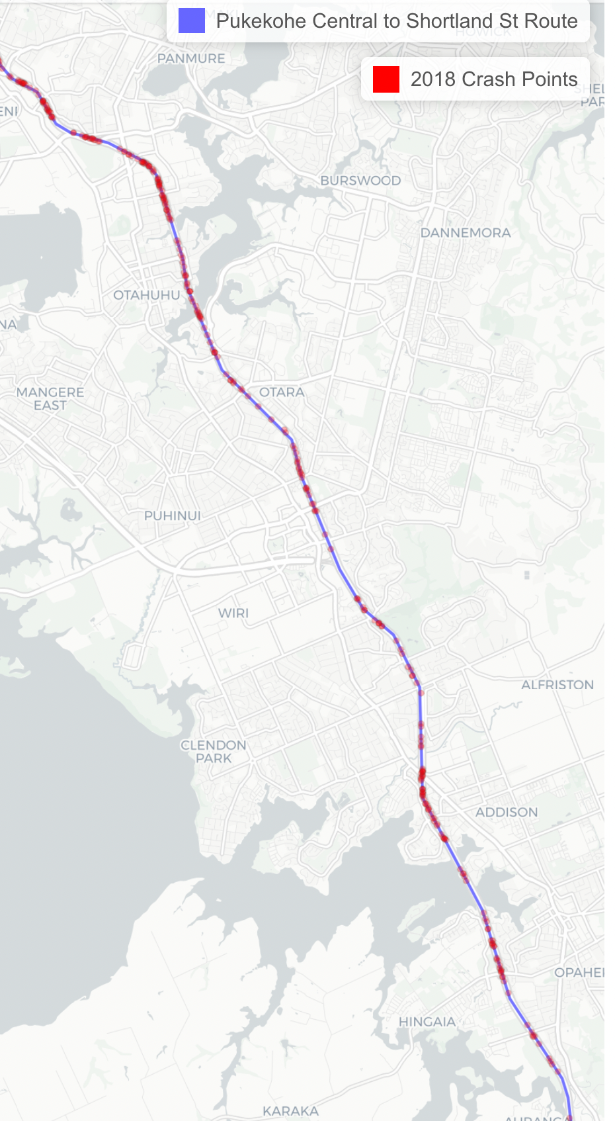
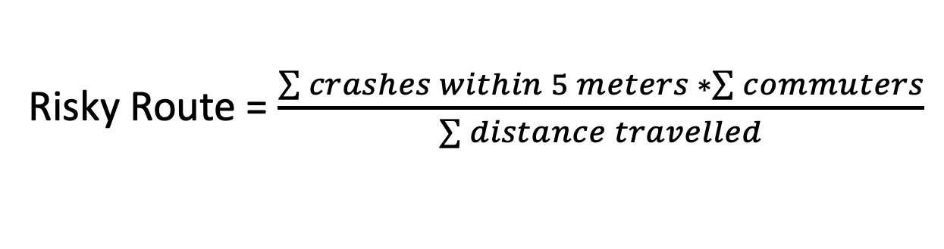
Route Riskiness
How risky is a commuter’s journey from home to work?
Risky Route = $\frac{\sum{crashes within 5 meters} ∗\sum{commuters}}{\sum{distance travelled}}$
Fig. Crashes within 5 meters from route
Notes:
We also wanted to quantify the riskiness of the journey. Route riskiness is calculated by identifying the total number of crashes, both injury and non-injury, in close proximity to each unique simulated route. This study assumes that crashes within 5 meters of the route exposes the commuter to road safety risks.
The plot on the right shows a group of commuters travelling from its usual residence in Pukekohe Central to its workplace in Shortland Street, Auckland Central. The 9 drivers taking this route travelled approximately 54 Km and mostly drove on the southern motorway. They have encountered 431 crashes located within 5 meters radius from the route in 2018. These crashes includes both non-injury and injury crashes.

Slide 13
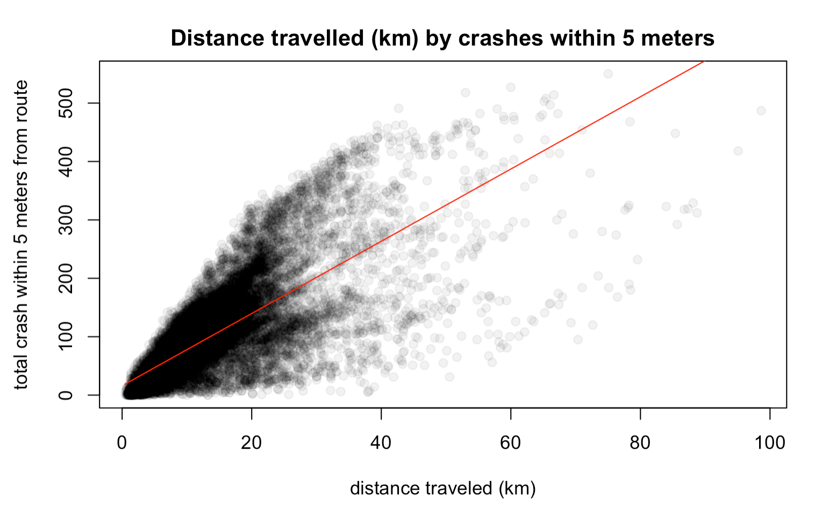
Risky Routes
Fig. Scatter plot
Increasing relationship between total crashes and total distance travelled.
‘Close to home’ effect on crashes that occurred at short distances (Burdett et al, 2017).
Reference: Burdett, B. R., Starkey, N. J., & Charlton, S. G. (2017). The close to home effect in road crashes. Safety science, 98, 1-8.
Notes:
The plot here represents the relationship between the total crashes encountered by a given route, and the distance travelled.
This represents a linearly increasing relationship between the total crashes, and the total distance travelled, as indicated by the red line.
However, we can’t discount the fact there are crashes that occurred over short distances and this is most probably because of the ‘close to home’ effect as cited by study conducted by Burdett and his colleagues

Slide 14
Spatial Autocorrelation
- Concept used to describe spatial variance in exploratory data analysis
Global Spatial Autocorrelation
Specifies the degree of clustering between neighbouring spatial units (Getis, 2010).
Using Moran’s I statistical test to determine global spatial autocorrelation (Getis, 2010).
O.62 Moran I statistics and the p-value has a significantly low value.
Local Spatial Autocorrelation (LISA) (Getis, 2010).
High values (HH) spatial unit neighbours
Low values (LL) spatial unit neighbours
Low values with high values in their neighbourhood (LH)
High values with low values in their neighbourhood (HL)
Reference: Getis, A. (2010). Spatial autocorrelation. In Handbook of applied spatial analysis (pp. 255-278). Springer, Berlin, Heidelberg.
Notes:
Spatial Autocorrelation is a concept used to describe the spatial variance in exploratory spatial data analysis [20]. Similar to correlation, positive autocorrelation refers to similar spatial units, while negative autocorrelation refers to less similar spatial units for a given variable.
Spatial autocorrelation has two methods global and local spatial autocorrelation. The global spatial autocorrelation refers to a global variance in the dataset and specifies the degree of clustering between neighbouring spatial units.
The variable used in this study is the route riskiness relative to the commuter’s usual residence, which is the statistical area 2
Moran’s statistics were used to determine that there is global spatial clustering.
Local Spatial Autocorrelation or LISA was then used to determine the local cluster, such as hot spots and cold spots, by identifying whether neighbouring spatial units have similar high or low values of the variable of interest

Slide 15
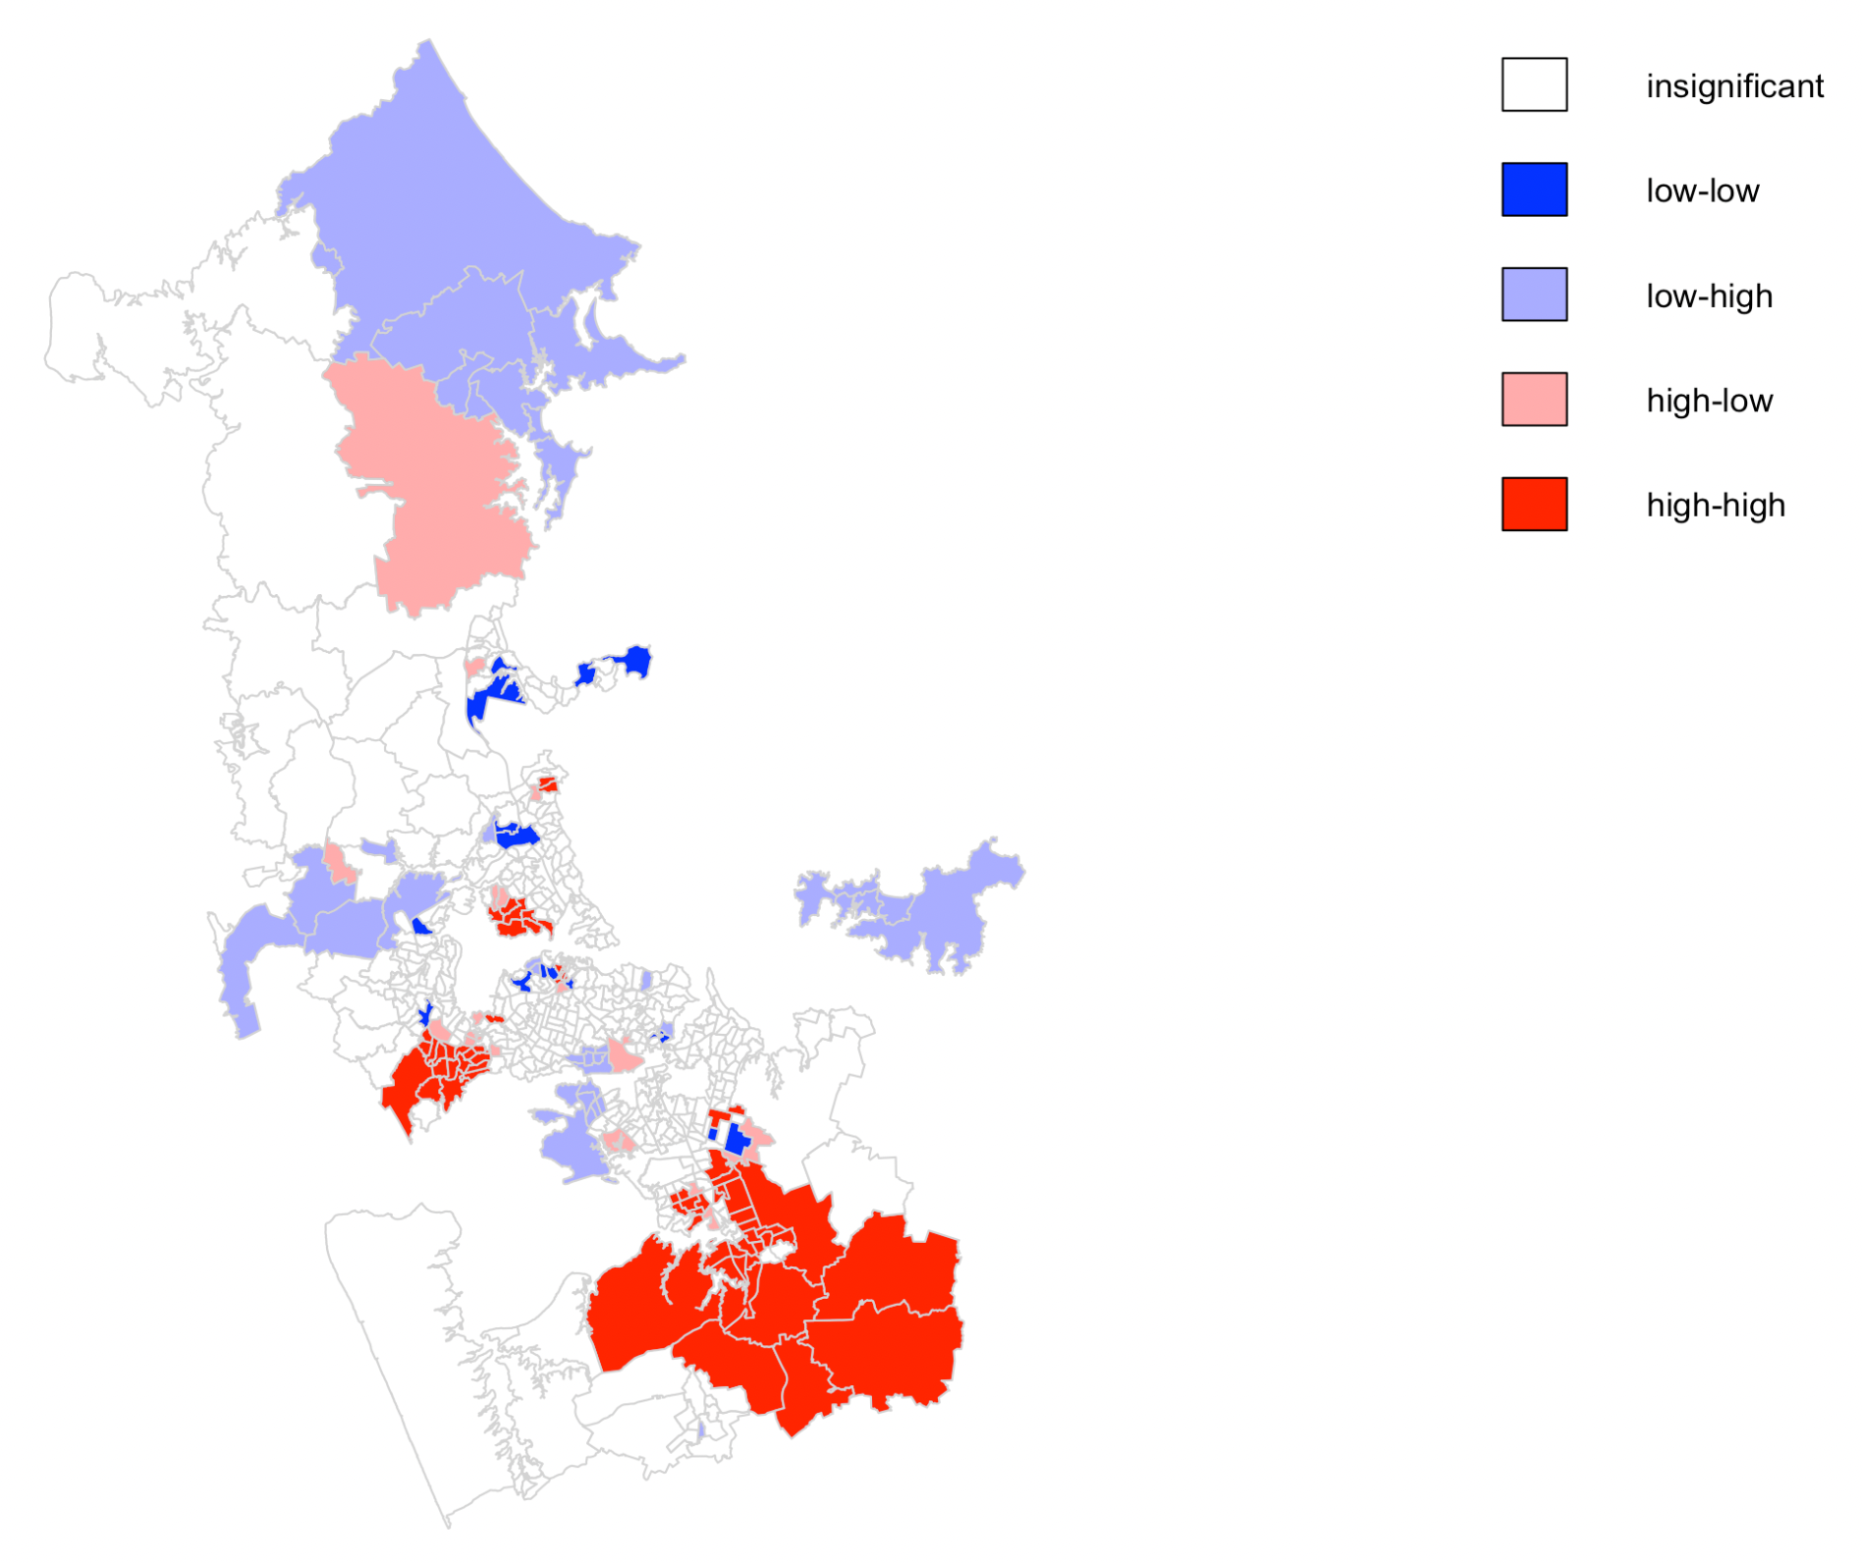
Spatial Autocorrelation
Global spatial clustering exist with 0.62 as the Moran’s I statistics
Spatial autocorrelation on between the spatial units and the risky routes aggregated per SA2
Northshore (Birkenhead area)
South Auckland
West Auckland (Titirangi area)
Fig. LISA Plot
Notes:
We have identified the existence of global spatial clustering with 0.62 as the Moran’s I statistics in this research.
The plot here represents local spatial autocorrelation. The bold red colours indicate neighbours clustered together who have encountered significant riskier routes and are surrounded by substantial riskier routes. These clusters are primarily located in the South of Auckland, where driving on motorways is more likely, and the distance travelled is longer. There are also solid red clusters in the West Auckland and Titirangi areas. The dark blue regions indicate route risk is low from the driver’s SA2 usual residence, surrounded by regions with lower route risk spread across Auckland.
In addition, Low-High and High-Low areas where high and low-risk regions are next to each other are also spread across Auckland.

Slide 16

Future Work
Simulate routes in granular detail, i.e., Statistical Area 1 (SA1), meshblock or actual addresses
Understand the effect of speed to road safety risk
Dissect the road into different parts, for example, road junctions, motorways, and suburban roads, to understand its relationship with traffic accidents throughout New Zealand
Extending to multi-modal commute (i.e., active modes such as walking and cycling)
Notes:
Journey to work data is aggregated which has an impact on the quality of route simulation.
Granular data would be useful to improve route simulation.
It would also be worthwhile to include speed and dissect the road into different parts, for example, road junctions, motorways, and suburban roads, to understand its relationship with traffic accidents throughout New Zealand.
Extending the research to multi-modal commutes such as walking or cycling from home to work would be beneficial in analysing road safety risk.
These are some future work to evolve this research.

Slide 17



Road safety is utmost priority.
Evolving road safety analysis with Spatial data analysis. kyco720@aucklanduni.ac.nz https://github.com/kathycong/motroadsafety
Notes:
Thank you for your time today and I hope that this research has provide some encouragement in involving road safety through spatial data analysis. Please feel free to reach out to me

