Slide 1
A Reoffending Evaluation of Alcohol Ignition Interlock sentences in New Zealand
Prepared by Gerald Waters of Researching Impaired Driving in New Zealand

Slide 2
Background

Slide 3
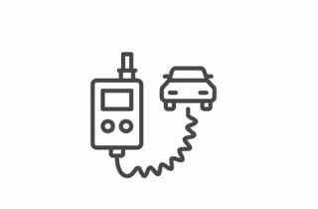


What is an Alcohol Interlock?
An Alcohol Interlock is a device similar to a breathalyser that is hard wired to the ignition of a vehicle
The vehicle will not start until a satisfactory breath sample is given
The driver must also perform random breath tests during the journey

Slide 4
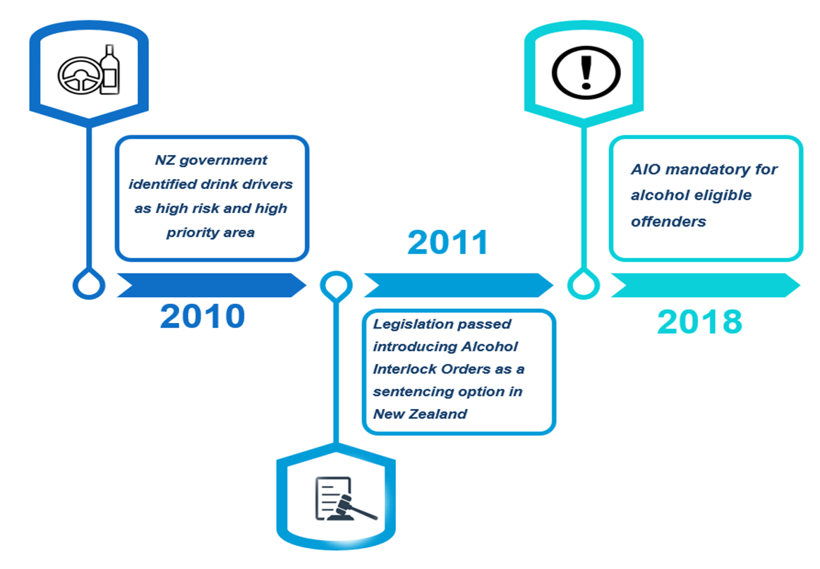
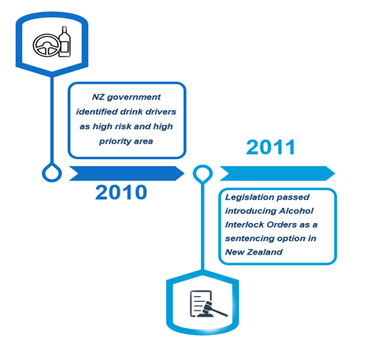

Alcohol Interlock Orders (AIO)
Overseas research shows significant reductions in recidivism ranging from 40-95% while interlock is installed in vehicle
Eligible offenders for Interlock order
Those with 2 offences within 5 years (based on offence dates)
OR
One offence of excess breath alcohol (EBA) of 800 mcg per litre

Slide 5

Aim of the study
Understanding reoffending rates amongst people who received an AIO order versus those who did not receive an AIO order

Slide 6
Research Methodology

Slide 7
Matched-case comparison method
Reoffending rates were compared for those who received AIO with those eligible but did not receive AIO
1st Jan 2013- 31st Dec 2017
Time period for the study
4:1
The average ratio at which propensity score matching was carried out

Slide 8
Inclusion Criteria for both AIO and Matched comparison group
had a finalised case with an Alcohol or Other Drug-eligible conviction from 2013 to 2017 AND
the offender was aged 20 or above AND
(3) includes only those receiving a fine through to home detention sentence.

Slide 9
Study groups
Eligible for AIO
31,037
Did not receive AIO
29,616
Matches
5,099
Other eligible offenders
24,517
Received AIO
1,421
Non-matches
150
Matches
1,271

Slide 10
Risk adjusted percentages
The risk-adjusted percentages use ratios of actual number of individuals with proved outcomes (i.e. charges proved in court to have been committed) with predicted numbers.
AIO group
Risk Adjusted Percentage = Actual %
Matched comparison group
Risk Adjusted Percentage = (Actual % x AIO Predicted %)
            Matched comp. Predicted %

Slide 11

It is worth noting that the matching is between those who received the AIO sentence; this does not necessarily guarantee that they had an interlock fitted

Slide 12
Results

Slide 13
Categories of Reoffending
The analysis covered three areas
Drink Driving reoffending
Disqualified Driving reoffending
All other reoffending

Slide 14
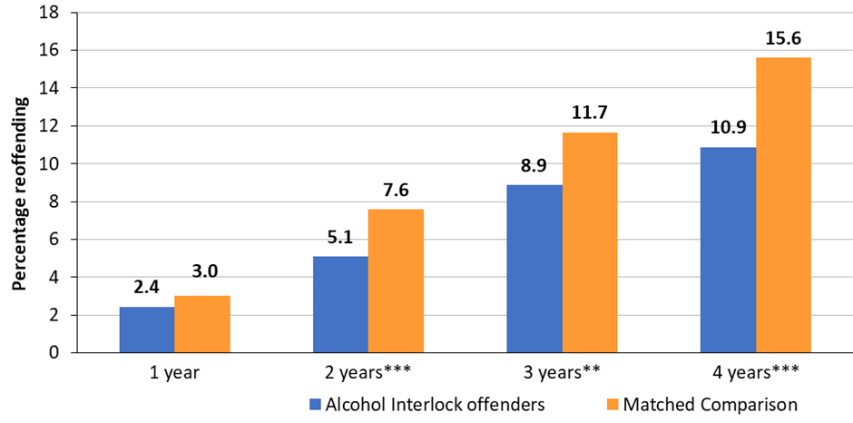
Drink driving reoffending results
*** significant at p=0.01 ** significant at p=0.05
Risk-adjusted percentage of reoffending for drink driving offences, after 1 to 4 years, by offender group

Slide 15
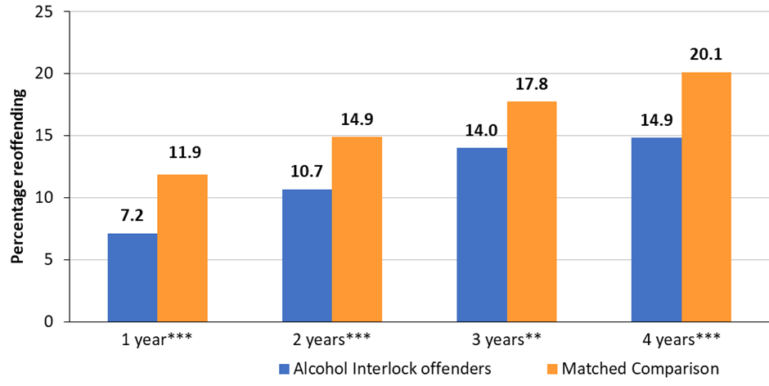
Disqualified driving reoffending results
*** significant at p=0.01 ** significant at p=0.05
Risk-adjusted percentage of reoffending for disqualified driving offences, after 1 to 4 years, by offender group

Slide 16
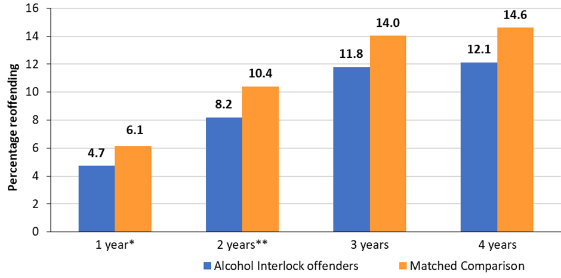
Other offending results
** significant at p=0.05 *significant at p=0.1
Risk-adjusted percentage of reoffending for other (non-drink/disqualified driving) offences, after 1 to 4 years, by offender group

Slide 17
Summary of findings
 | Drink driving | Disqualified driving | Other offending
1 year | No difference
2 years
3 years |  |  | No difference
4 years |  |  | No difference

Slide 18
Data limitations

Slide 19
Limitations
There is no set timeframe within which the interlock must be fitted.
No data gathered on interlock installations against Alcohol Interlock licenses issued.
The study does not ascertain effectiveness of AIO due to lack of installation duration data.
The comparison data variables do not include employment or income data.

Slide 20
Next steps

Slide 21

Recommendations
A study to assess why the interlock sentence is not being fully utilised at Court
A scoping study to ascertain what types of data can be utilised and from what agencies, and the feasibility of
  An inter-agency evaluation framework
  A longitudinal evaluation study

Slide 22
Q/A session

